Slide 1
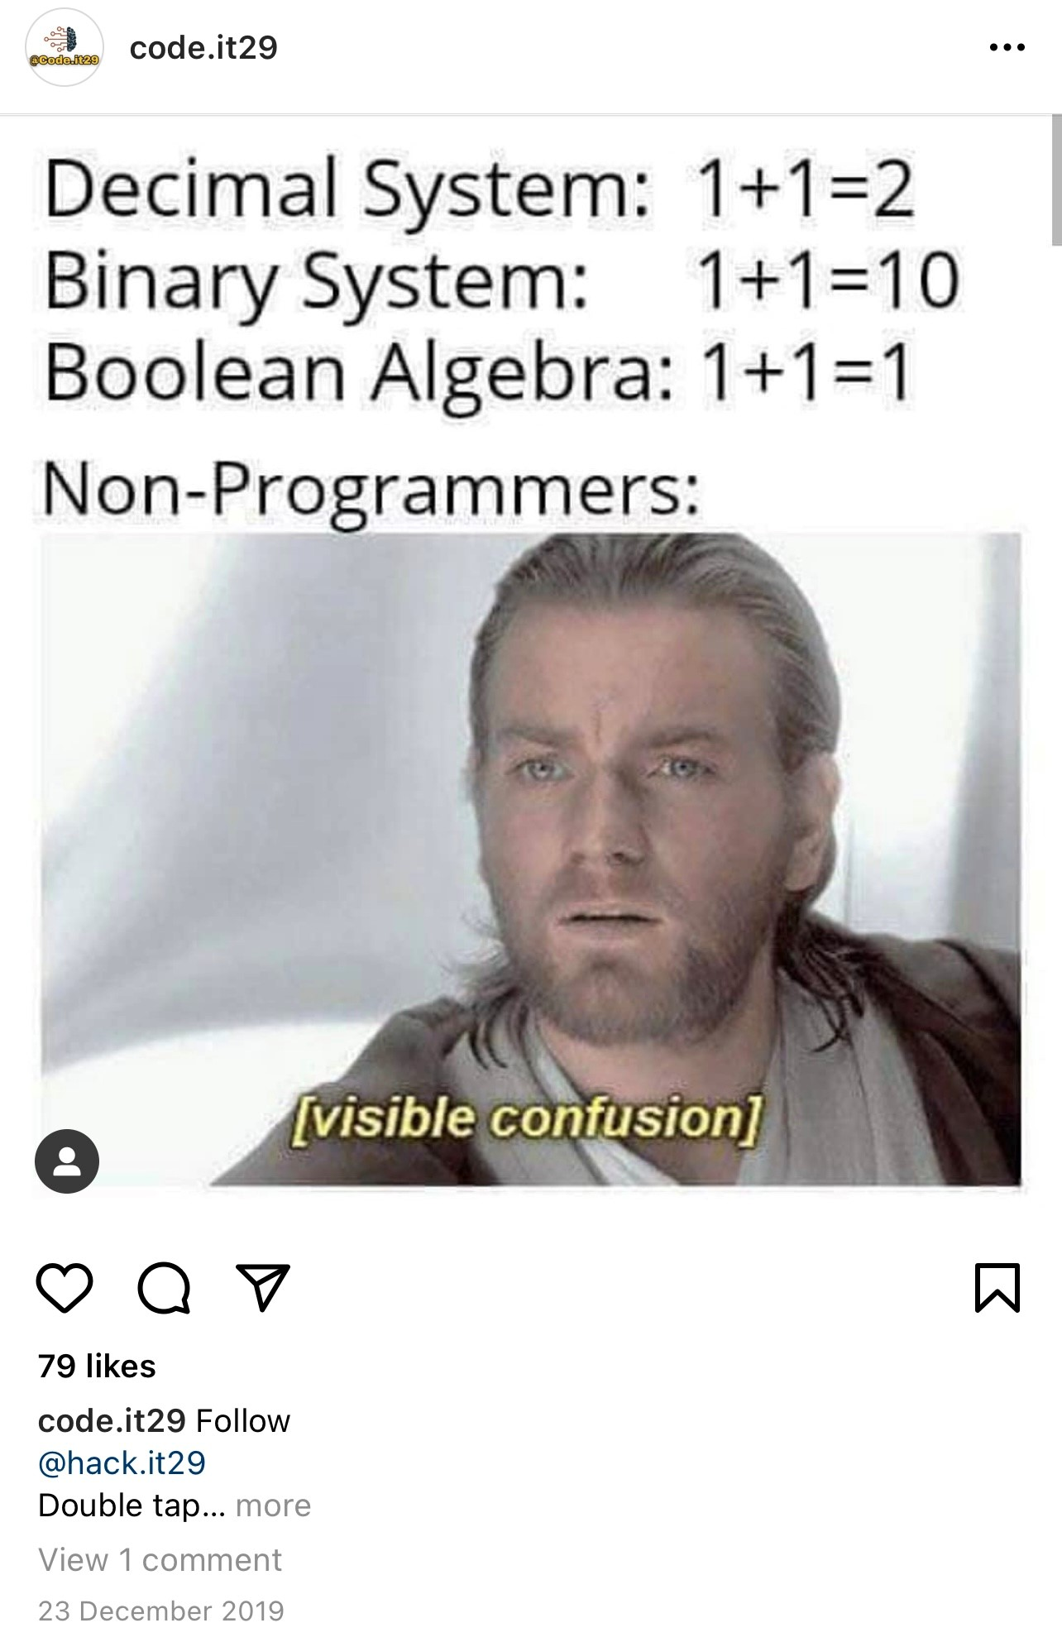
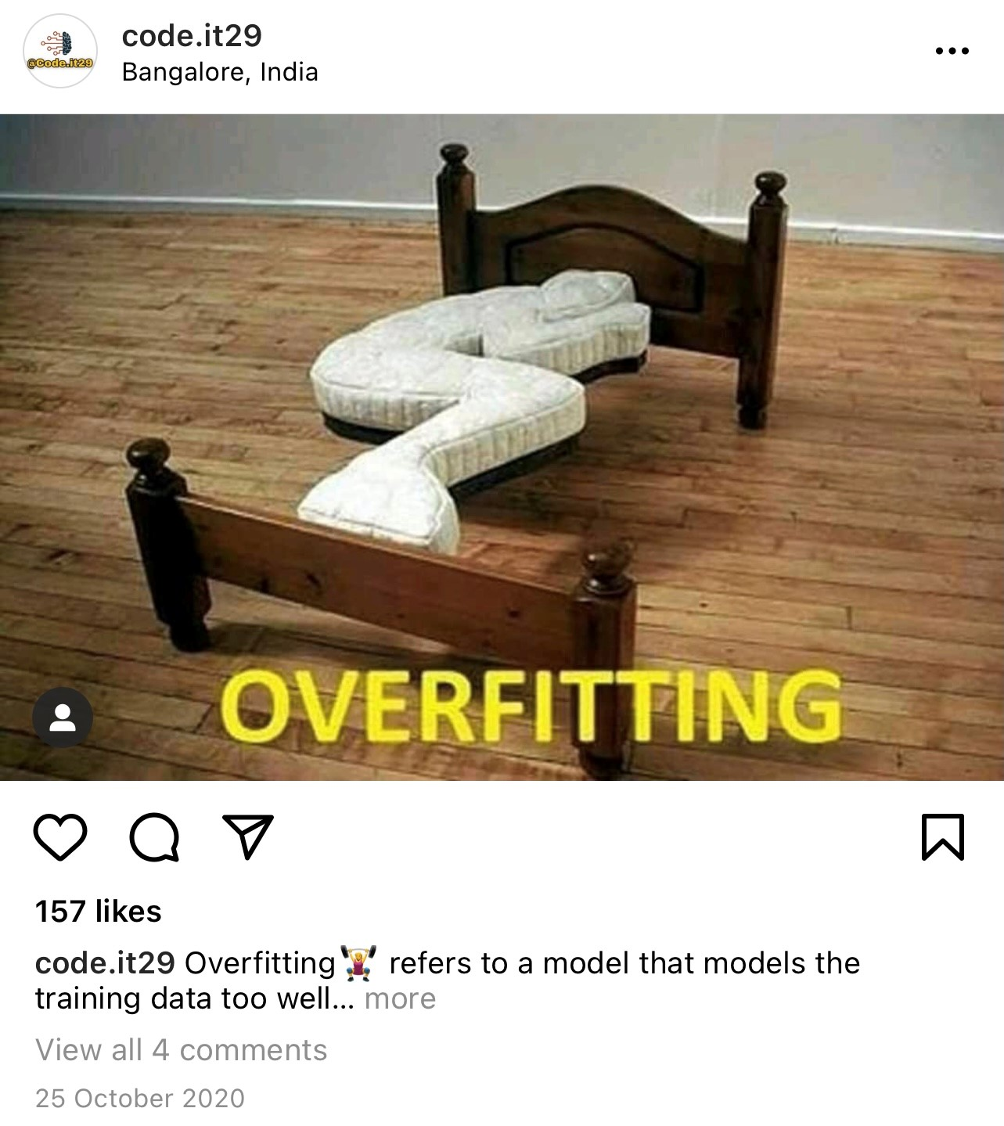
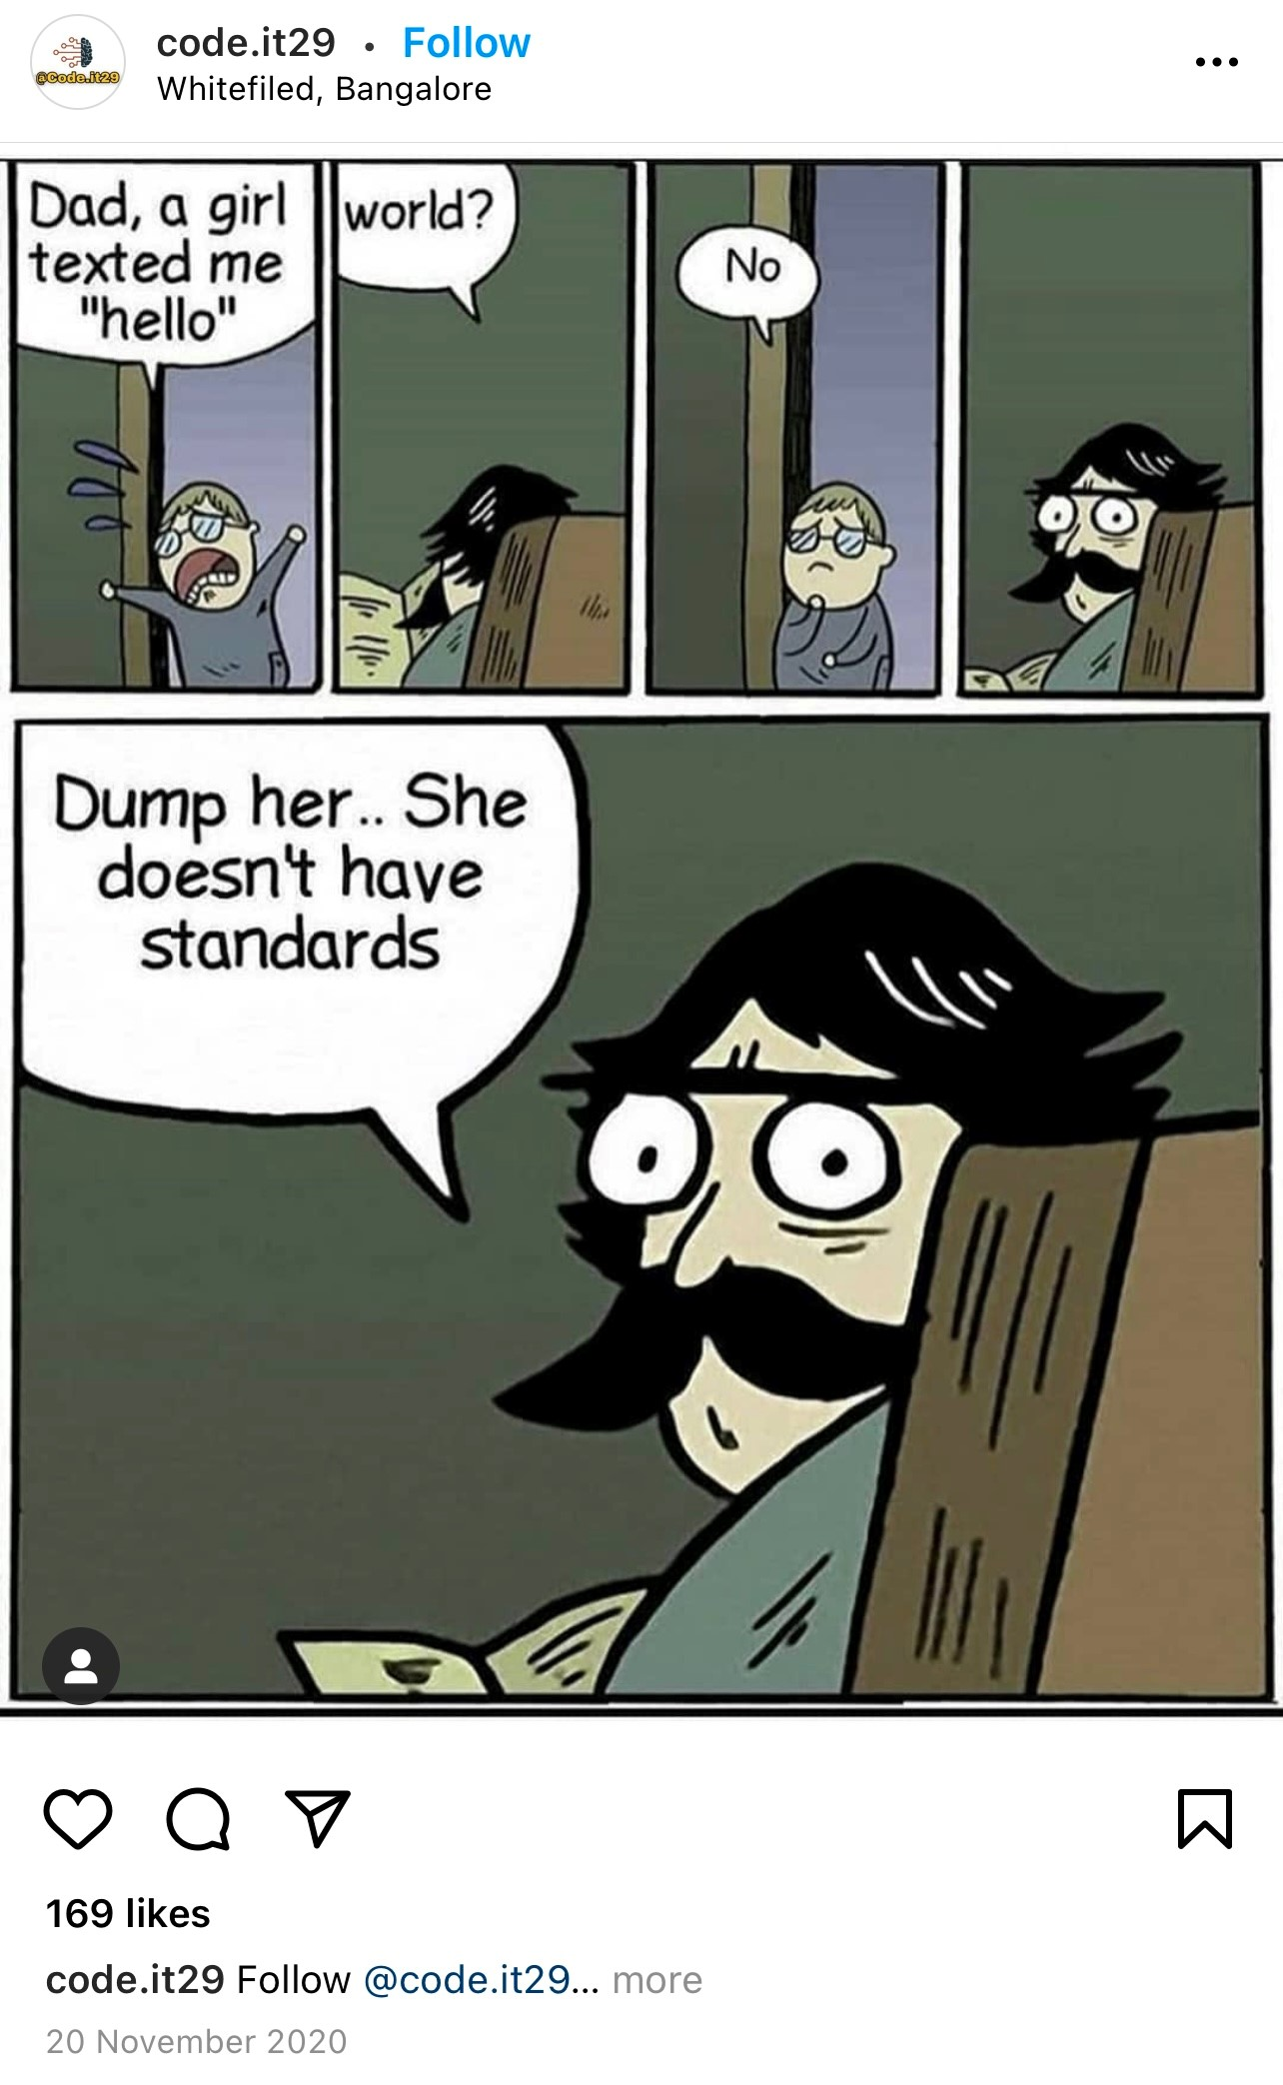

Slide 2
0
1
3
2

Slide 3
Back in Sept 2020…
Aditya hired me, knowing I have ZERO knowledge in Python.
Earlier this year…
Aditya sent me for Python courses with the Python God Fredy.
Nonetheless, he wants to assess my level of noob-ness…
by tasking me to build Machine Learning Models to get a sense of :
Aditya knows…
that this is a generation of time-enslaved and attention-deficient individuals, and so the Instagram posts he creates has to be one of the top posts.
Aditya wants…
to improve his training center’s business and, he knows that his target audience are a generation who uses Instagram more religiously than religion.
Aditya wants…
to create awareness and increase exposure of the Xaltius brand, such that :
Aditya knows...
that “one cannot conquer the deadly snake within 1.5 months”.
I am…
a data analyst working for Boss Aditya.
WHAT MAKES
AN INSTAGRAM TOP POST
WHO AM I ?

Slide 4
WHAT MAKES AN INSTAGRAM TOP POST
A Python driven approach

Slide 5
agenda
WHAT MAKES AN INSTAGRAM TOP POST
Introduction
Methodology
Process Workflow
Results
Takeaways

Slide 6
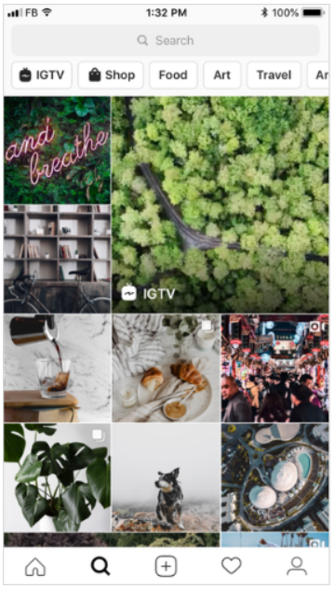
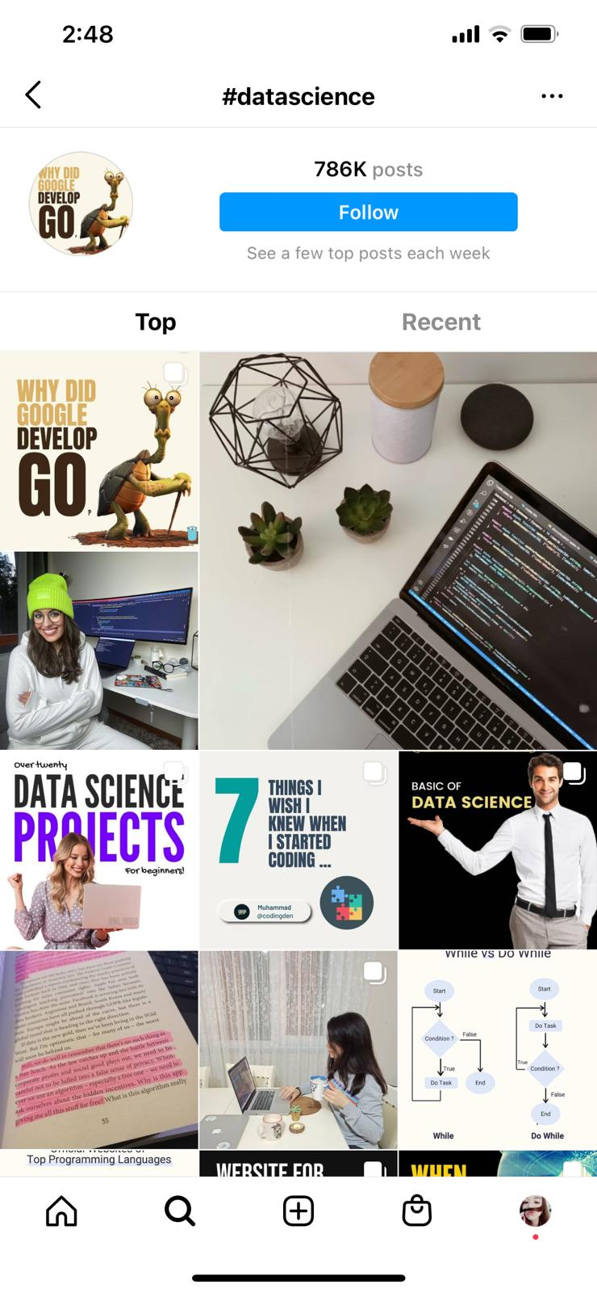
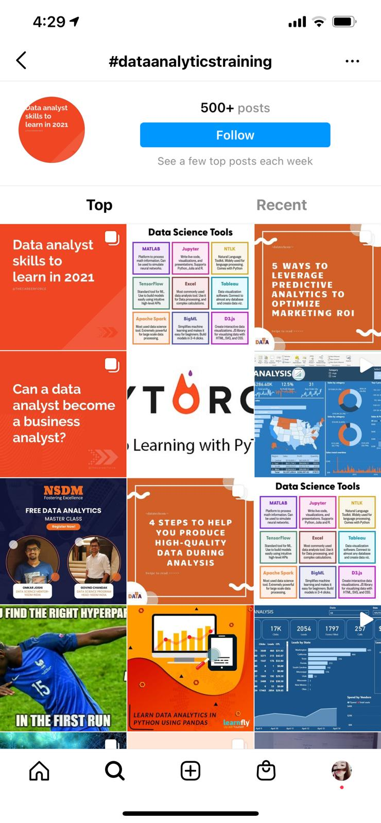
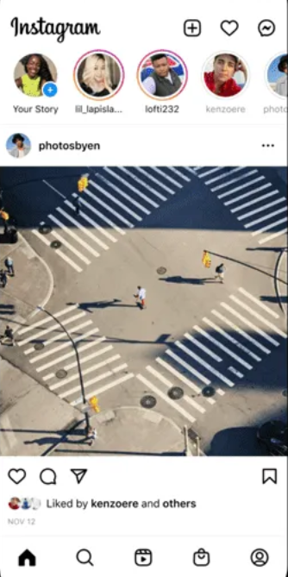
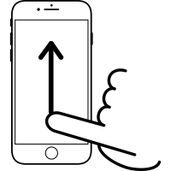
introduction
WHAT IS AN INSTAGRAM TOP POST
Explore tab
Home tab
#dataanalyticstraining
#datascience
#AdiWants

Slide 7
methodology
DATASET | MODELS | METRICS
VARIABLES
Which are the super variables I should focus my efforts on,
in my trajectory to making Instagram top posts?
height
width
has_audio
video_view_count
is_video
is_verified
followers_count
comments_count
hashtag_count
like_count
tag_name
caption_length
MACHINE LEARNING MODELS USED
Logistic Regression
Random Forest
Dataset Source
https://www.kaggle.com/rezaunderfit/instagram-top-post

Slide 8
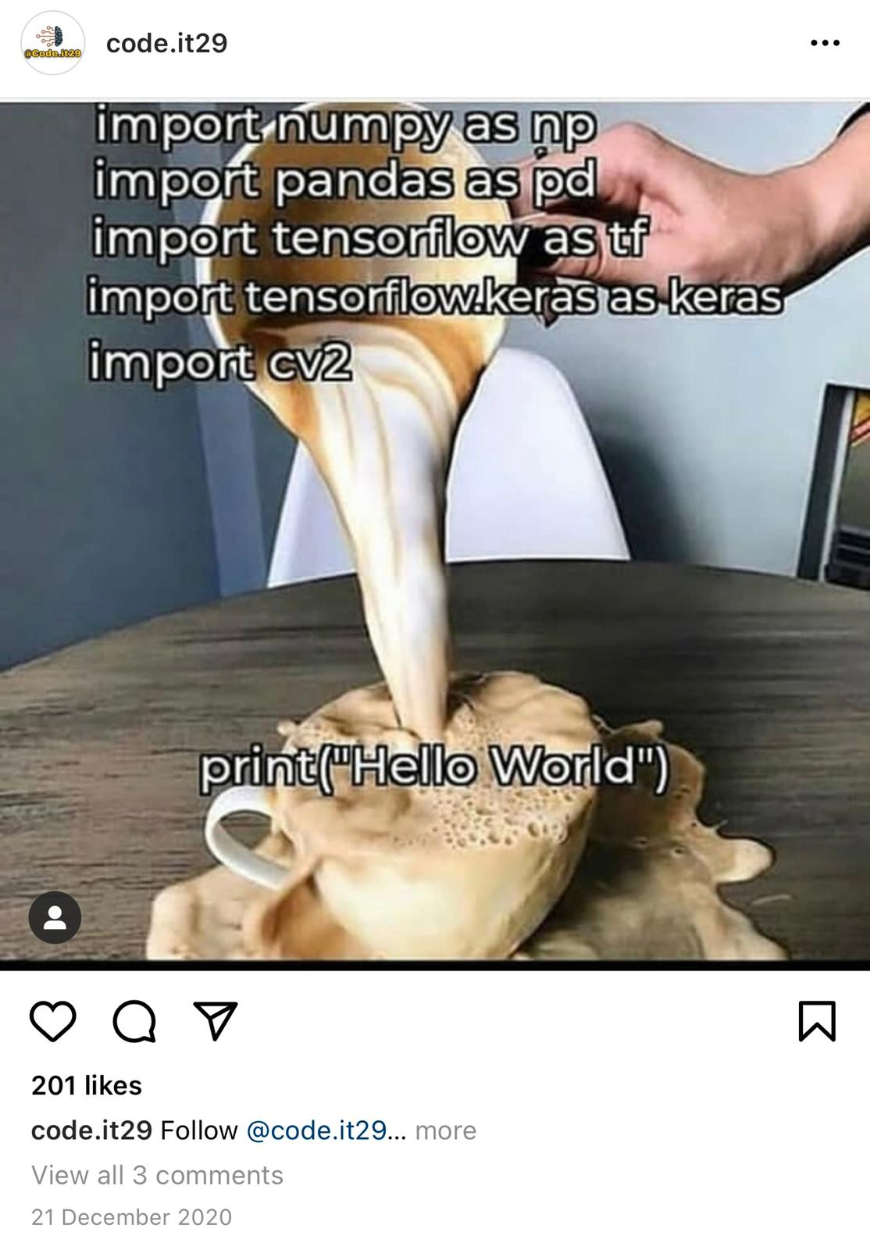
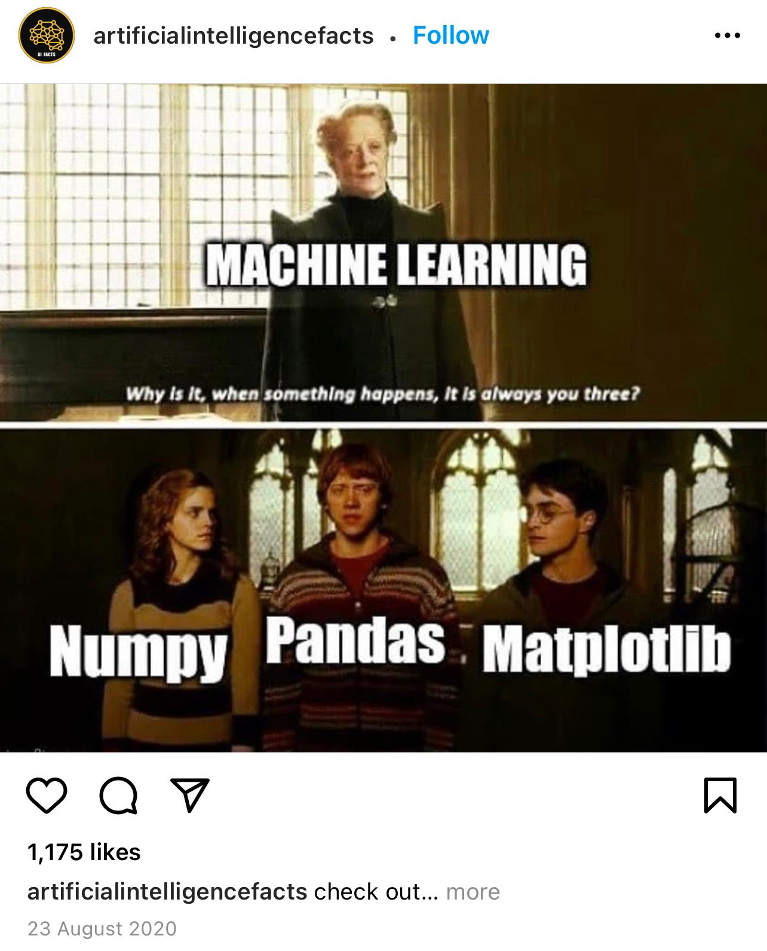
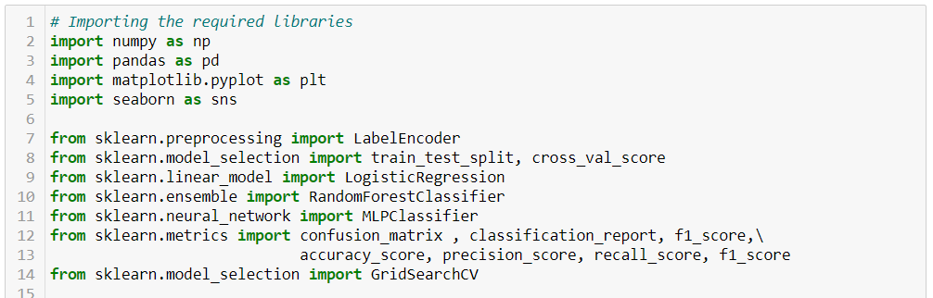
process workflow
IMPORT REQUIRED LIBRARIES
#datascience

Slide 9
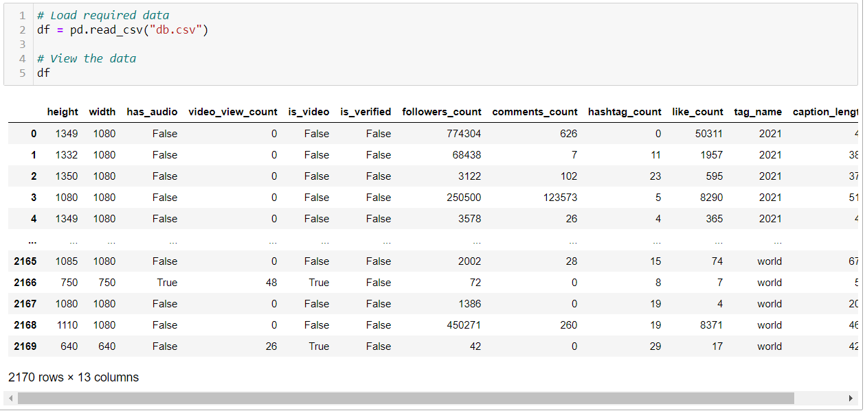
process workflow
LOAD IN DATA
#datascience

Slide 10
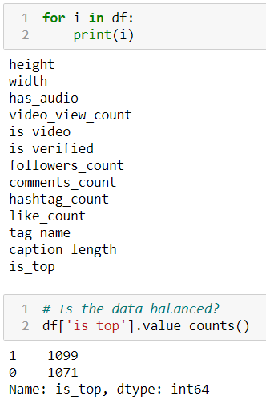
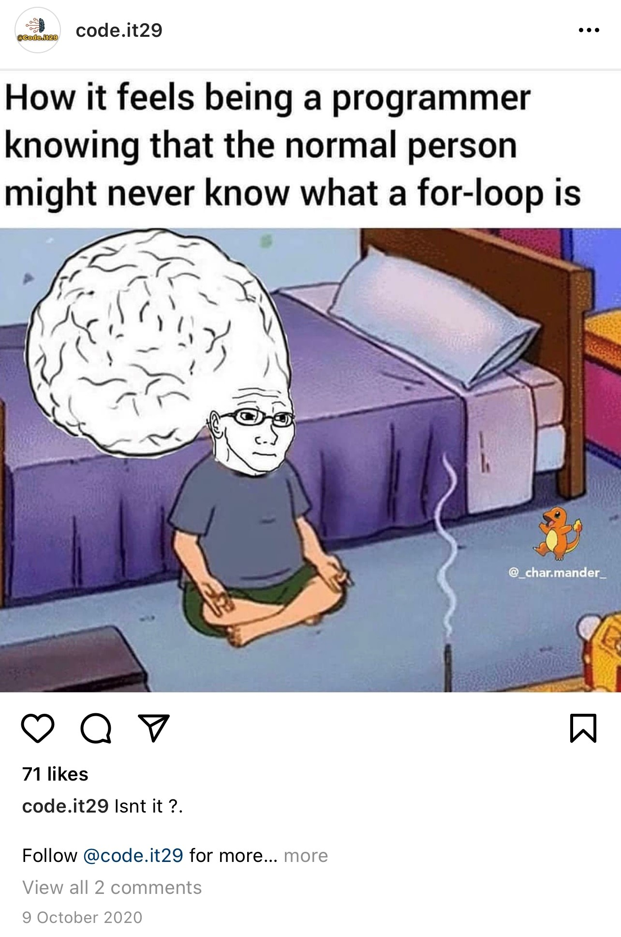
process workflow
IS THE DATA BALANCED ?
#datascience

Slide 11
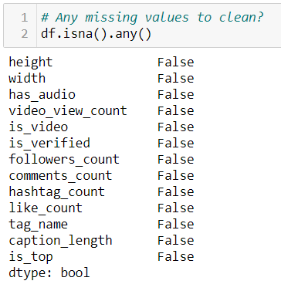
process workflow
DATA PRE-PROCESSING & EDA
#datascience

Slide 12
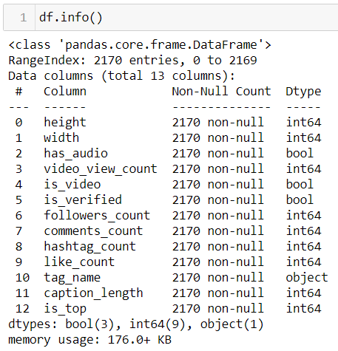
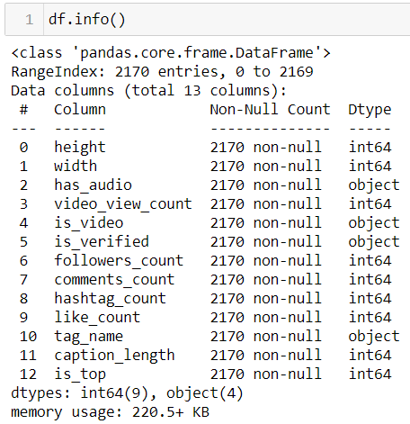
process workflow
DATA PRE-PROCESSING & EDA
#datascience

Slide 13
process workflow
DATA PRE-PROCESSING & EDA
#datascience

Slide 14
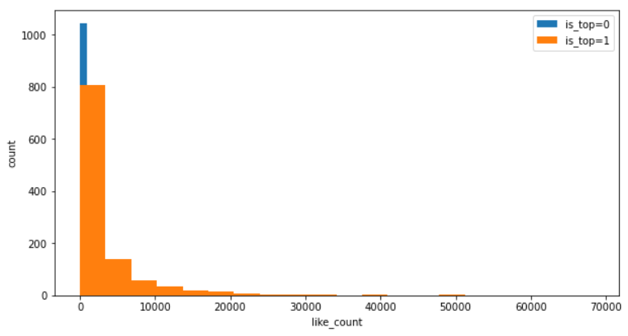
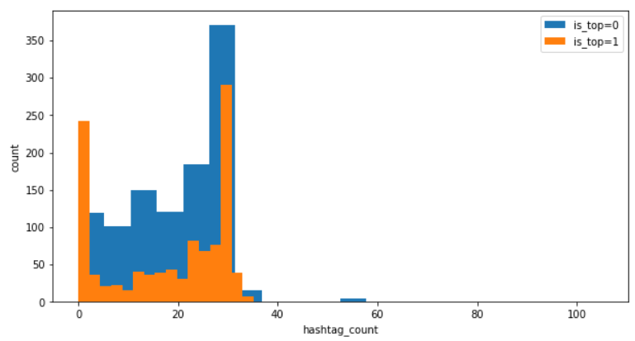
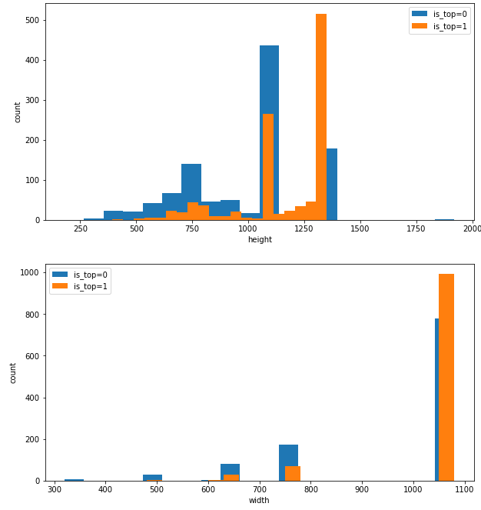
process workflow
PRE-PROCESSING & EDA
#datascience
hashtags not necessarily
!= top post
Images need to be
relatively sizable.
Most top posts have
around 3000-ish likes

Slide 15
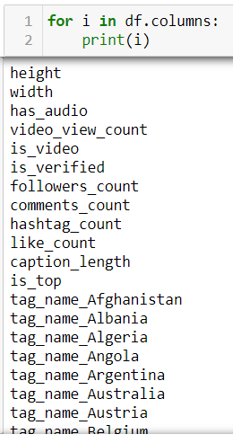
process workflow
PRE-PROCESSING & EDA
#datascience

Slide 16
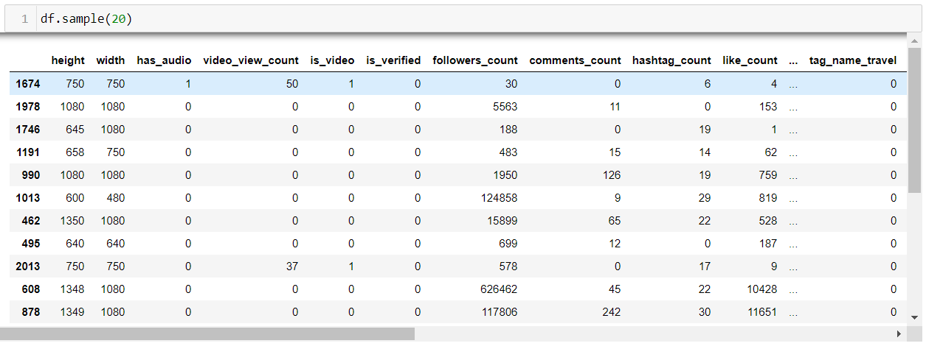
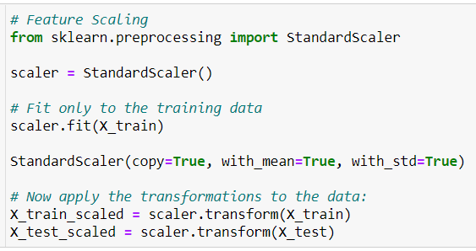
process workflow
PREP DATA FOR TRAINING & TESTING | FEATURE SCALING
#datascience

Slide 17
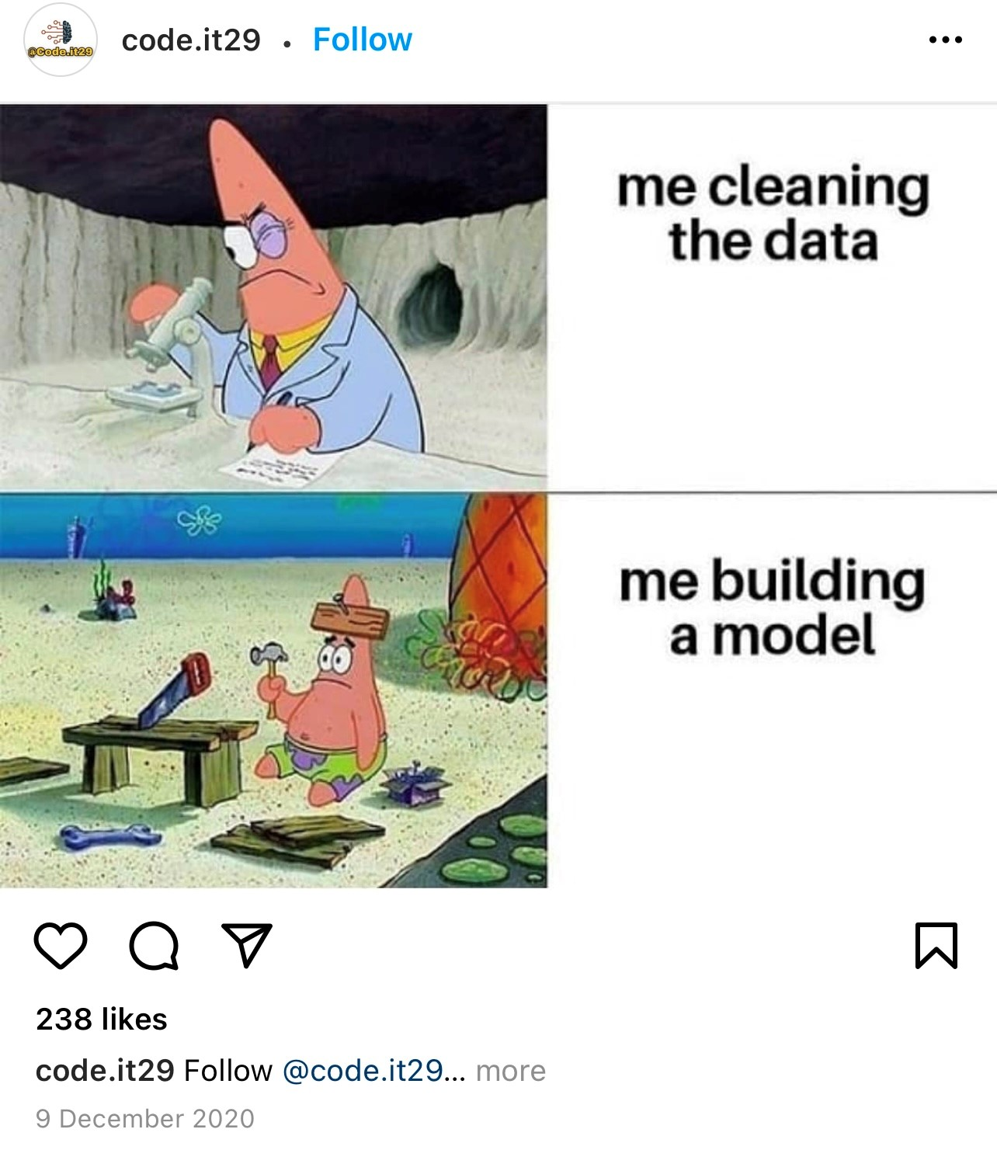
process workflow
BASELINE MODEL USING LOGISTIC REGRESSION
Store classifier in an object
#datascience
Using 75% of the data for Training & Validation…
F1 scores are only in the low 80’ s…

Slide 18
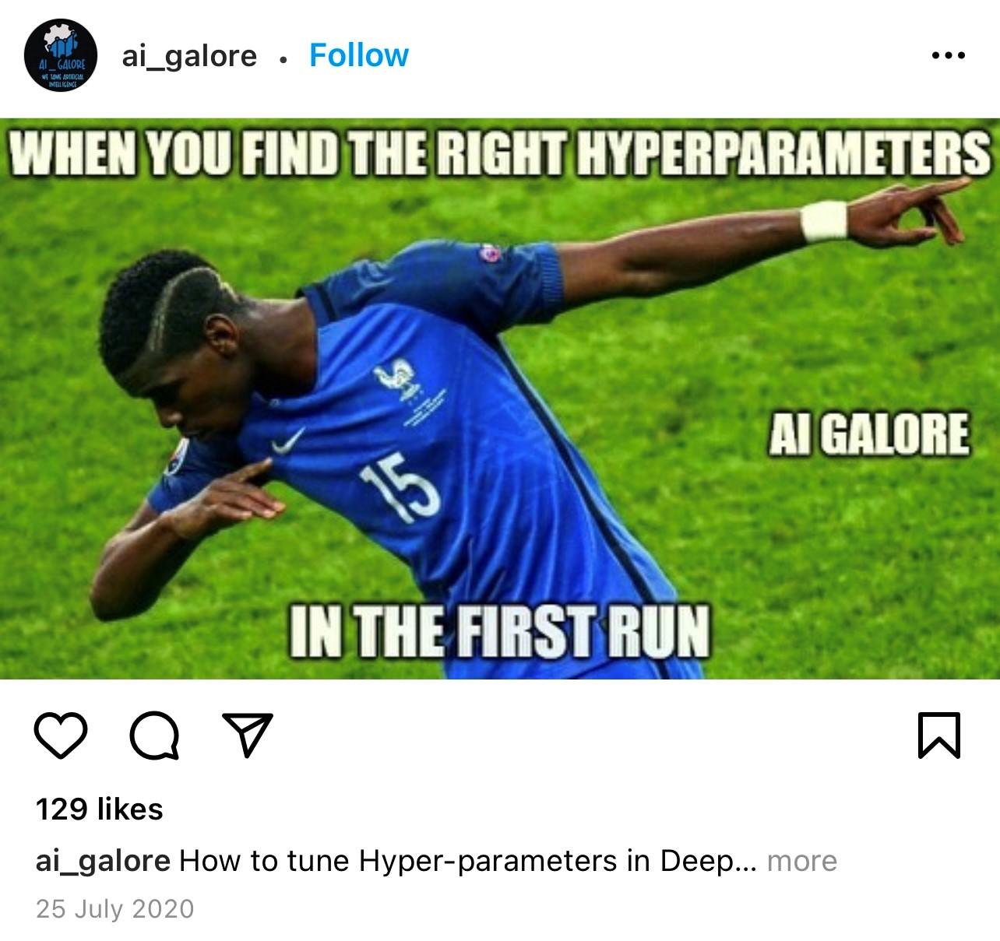
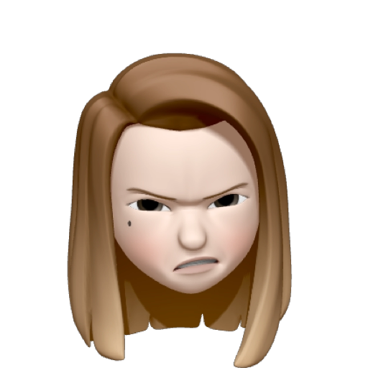
process workflow
ML_MODEL_ONE : LOGISTIC REGRESSION
Store classifier in an object, utilize all processors to run in parallel…
Manhattan
Distance
Euclidean
Distance
Hyperparameter tuning…
Regularized regression method that linearly combines the L₁ and L₂ penalties of the lasso and ridge methods
Avg w/o caring about proportion

Slide 19
process workflow
ML_MODEL_ONE : LOGISTIC REGRESSION
Ze best hyperparameters…
Using ze best estimators…
Predicting with the Test data,
and the results are…
F1 scores are in the high
80’ s!

Slide 20
process workflow
KEEPING TRACK OF MODEL METRICS
#datascience

Slide 21
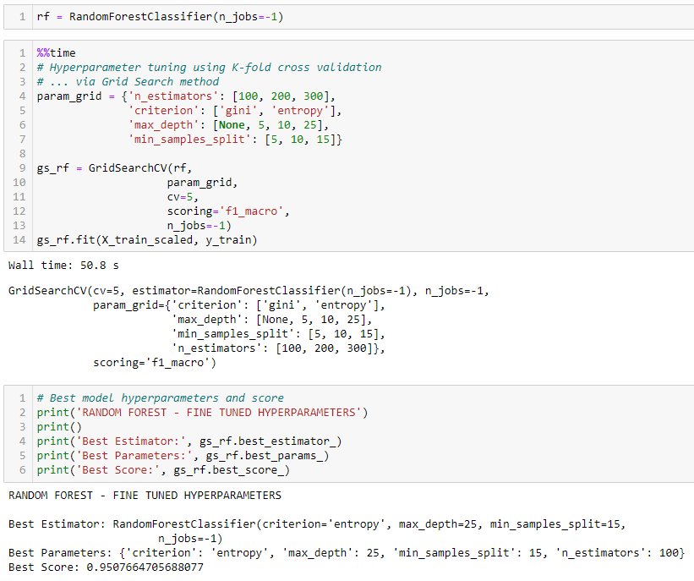
process workflow
ML_MODEL_TWO : RANDOM FOREST
Store classifier in an object, utilize all processors to run in parallel…
# of trees to create
Hyperparameter tuning…
Depth of each tree

Slide 22
process workflow
ML_MODEL_TWO : RANDOM FOREST
Ze best hyperparameters…
Using ze best estimators…
Predicting with the Test data

Slide 23
process workflow
ML_MODEL_TWO : RANDOM FOREST
F1 scores are in the 90’ s!
#datascience
Append results to the Tracking list….

Slide 24
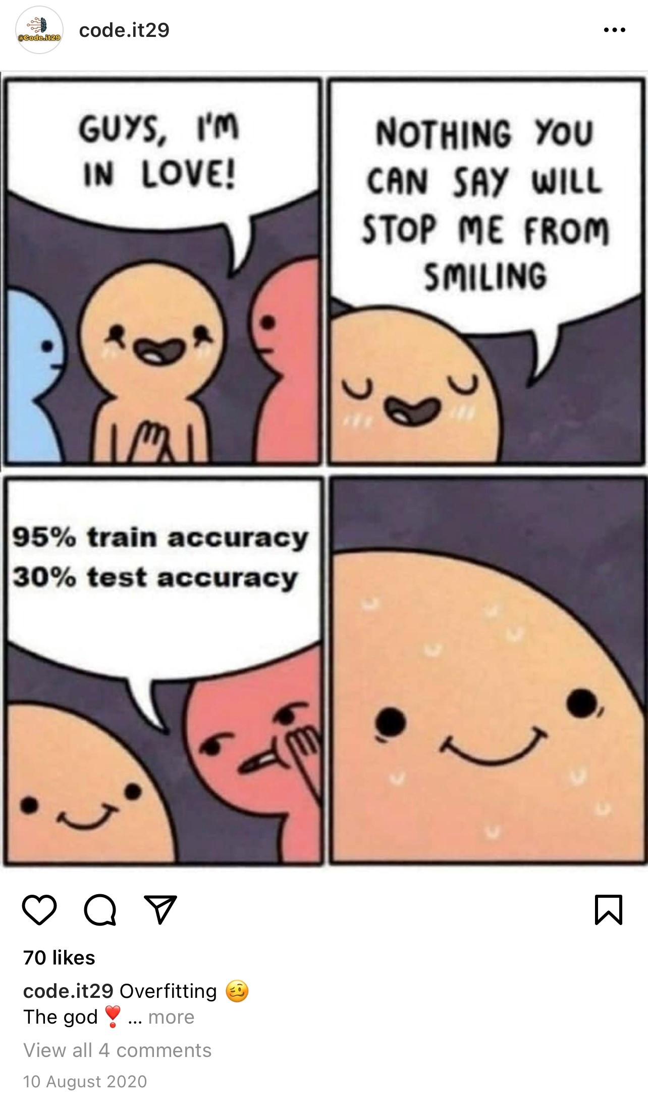
results
ACCURACY, PRECISION, RECALL, F1 SCORE
Summarizing the Models’ metrics…
#datascience
🙌🏻

Slide 25
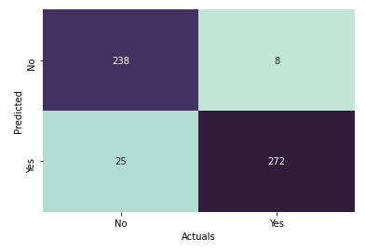
results
THE CONFUSION MATRIX
Plotting the results in a Confusion Matrix…
#datascience

Slide 26
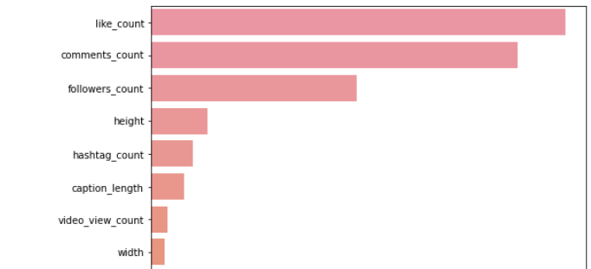
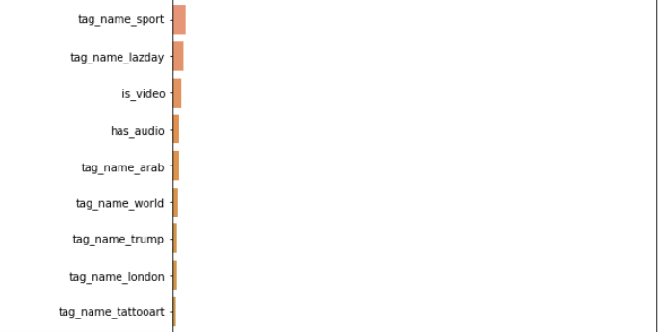
takeaways
FEATURES IMPORTANCE
#datascience
The data driven approach proposes that:
The number of likes, comments, and followers are the super features which greatly contributes to whether a post can make it to the top.
{ ‘like_count’ : >0.3,
‘comments_count’ : ~0.28,
‘followers_count’ : ~0.16 }
.
.
.
.
.

Slide 27
takeaways
RECOMMENDATIONS
Data-driven approach recommends to focus on creating content which:
aim to provide instant gratification → likes
encourages engagement → comments
is addictive → followers
Building a brand is like a relationship. It does not happen overnight!
Takes time, consistency… different folks, different strokes
Post at the optimal time
Use relevant hashtags (increase exposure to people that matter)
Create out-of-the-box content (aim to make impact and not follow the crowd blindly)
Aim to connect, resonate with target audience
Psychological vulnerabilities:
* Slot machine effect of getting intermittent, variable rewards… “Did I get a DM?”
* The need to be seen… “Notice me! Acknowledge me! Like me!”
* The need to reciprocate… “I have to respond to say thanks!”
* The fear of missing out
* Masochistic impulse – to constantly compare ourselves to others
#datascience
“The data is like that.”

Slide 28
MISSION COMPLETE

Slide 29
