Slide 1
A not so long time ago on earth not so far
far away….

Slide 2
Earlier on…
( summary – if you have missed the opening crawl )
AUG 2020
* Interviewed with Aditya
SEP 2020
* Joined Aditya’s company
* Submitted my 1st project of building an Excel Interactive Dashboard for the Superstore business in the U.S.
* Aditya is convinced of my Dashboard building skills
NOW . . . .
* Aditya wants to venture into the business of MOVIE MAKING
* He requires an overview of the movie industry, but information is not readily available, and data is too massive to process in excel
* Aditya tasked me to handle this project, with an objective to gain key insights
(and of course secretly measure my SQL skills …. )
CAPSTonE
pRojeCT2
It is a period of great milestones. I had interviewed with Aditya
for the role of Data Analyst back in August where he hired me because
I said I could use SSMS to load, clean, retrieve data with analyses, and
create interactive Excel dashboards for business presentations.
I joined Aditya’s company in September where he had tasked me with
my first project of building an interactive dashboard for the Superstore
business in the U.S. That being done and dusted, he is convinced of my
excel dashboard building skill but remains doubtful of my SQL.
This time, Aditya is looking to venture into movie making and would like
to get brief insights like “what is the trend of genres over time”,
“what movies have the highest return on investment, and
BLAH BLAH BLAH” AS HE USUALLY GOES.
Now, he has assigned this project to me, with a side objective of
measuring my aptitude in SQL ….

Slide 3
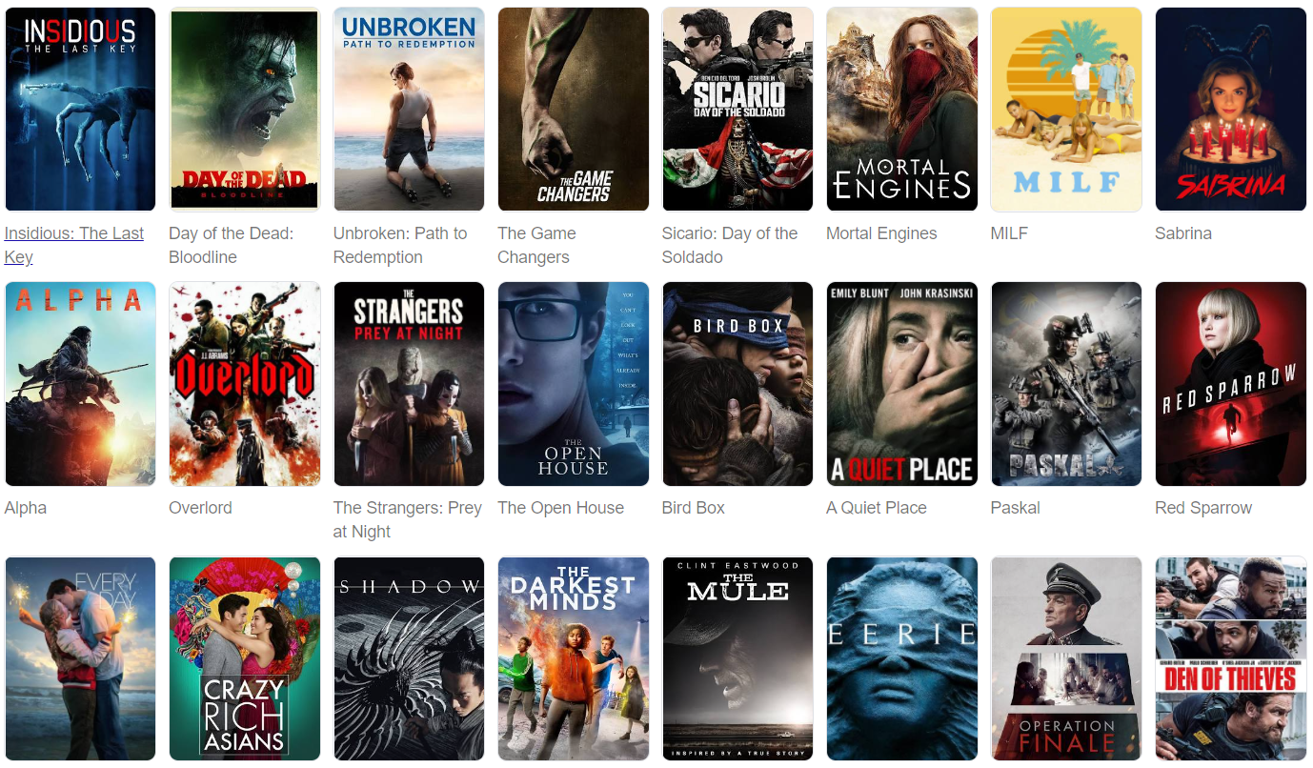
THE MOVIE INDUSTRY
An Overview

Slide 4
AGENDA
The Movie Industry | An Overview
Introduction
ER Diagram
SQL
Dashboard Takeaways

Slide 5
INTRODUCTION
The Movie Industry | An Overview
SOURCE
https://www.kaggle.com/rounakbanik/the-movies-dataset
FILES
movies_metadata.csv (45,000+ rows)
Contains info on movies with attributes of release dates, franchise family, genres, budget, revenue, homepages, production company, etc.
credits.csv (45,000+ rows)
Consists of Cast and Crew Information per movie, in the form of a stringified JSON Object
ratings.csv (More than 1,048,576 rows)
Contains the TMDB and IMDB IDs of all the movies featured in the Full MovieLens dataset
links.csv (45,000+ rows )
List of mappings of corresponding TMDB, IMDB, and Movie IDs

Slide 6
INTRODUCTION
The Movie Industry | An Overview
PREVIEW OF QUESTIONS ANSWERED
How many movies are released per year / month
How does the trend of released movies look like from an angle of Year-on-Year, or Month-on-Month
What are the most often produced genres
What is the trend of genres over the years
What are the top produced franchise movies
What movies have the highest return on investment
What movies raked in the most revenue
What movies are the most expensive to produce
And others….

Slide 7
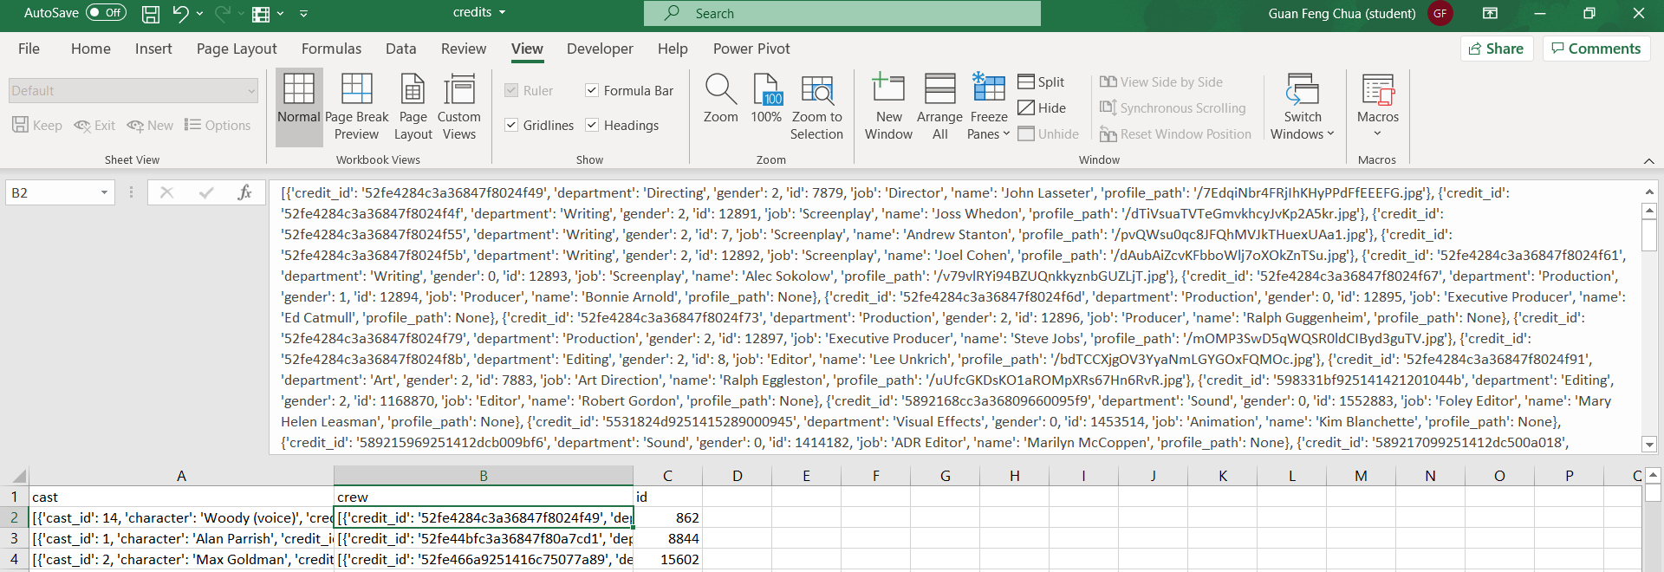
ER DIAGRAM
The Movie Industry | An Overview
homepage
video
movie id
popularity
poster path
original title
user id
rating
vote count
timestamp
vote
LINKS
M
RATINGS
production country
1
production
company
movie id
tmdb id
genre
MOVIE
imdb id
id
1
revenue
credited
to
1
CREDITS
cast
budget
crew
runtime
adult
released date
status
belongs to
collection
id
original
language
imdb id
title

Slide 8
ER DIAGRAM
The Movie Industry | An Overview
homepage
video
movie id
popularity
poster path
original title
user id
rating
vote count
timestamp
vote
LINKS
M
RATINGS
id
production country
id
1
production
company
movie id
tmdb id
director name
genre
MOVIE
imdb id
cast cluster
1
cast 1
revenue
credited
to
1
CREDITS
budget
cast 2
cast 3
runtime
adult
cast 4
released date
status
cast 5
belongs to
collection
id
original
language
imdb id
title

Slide 9
ER DIAGRAM
The Movie Industry | An Overview
id
homepage
video
movie id
genre cluster
user id
rating
action
popularity
poster path
original title
adventure
vote count
timestamp
animation
LINKS
M
RATINGS
comedy
vote
id
crime
production country
documentary
1
id
drama
production
company
movie id
tmdb id
director name
family
fantasy
GENRE
M
falls under
M
MOVIE
imdb id
cast cluster
foreign
1
history
revenue
credited
to
1
CREDITS
cast 1
horror
cast 2
music
budget
mystery
cast 3
romance
runtime
adult
Science fiction
cast 4
released date
status
thriller
cast 5
tv movie
belongs to
collection
id
original
language
war
imdb id
title
western

Slide 10
ER DIAGRAM
The Movie Industry | An Overview
id
homepage
video
movie id
genre cluster
user id
rating
action
popularity
poster path
original title
adventure
vote count
timestamp
animation
LINKS
M
RATINGS
comedy
vote
id
crime
production country
documentary
1
id
drama
production
company
movie id
tmdb id
director name
family
fantasy
GENRE
M
falls under
M
MOVIE
imdb id
cast cluster
foreign
1
history
revenue
credited
to
1
CREDITS
cast 1
horror
cast 2
music
budget
mystery
cast 3
romance
runtime
adult
Science fiction
cast 4
released date
status
thriller
cast 5
tv movie
belongs to
collection
id
original
language
war
imdb id
title
western

Slide 11
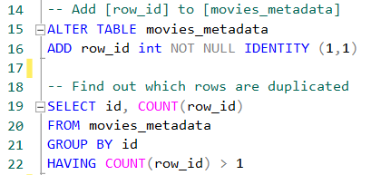
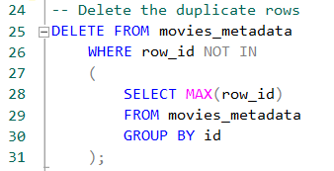
SQL
The Movie Industry | An Overview
PROCESS – Creating Database, Loading Data, Data Preparation
Create a new database named ‘MOVIES’
Upload the files
Check tables for duplicate rows & delete
[movies_metadata]
[genres]
[credits]
By creating a new column [row_id]
Performing aggregate functions to view duplicates
Delete rows (with conditions, in a subquery)

Slide 12
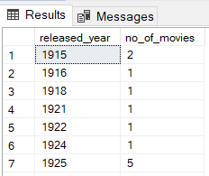
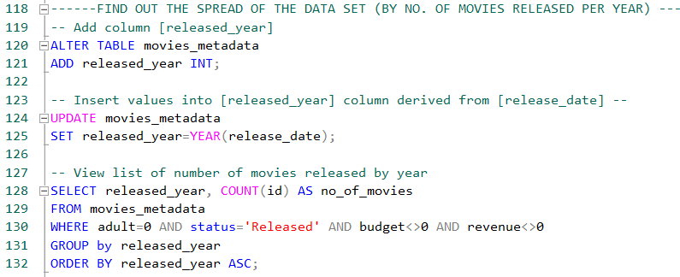
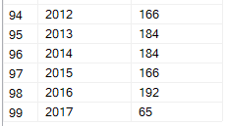
SQL
The Movie Industry | An Overview
PROCESS – Data Analysis
Top-down approach
Quick insight :
99 years of data starting from Year 1915
Data is relatively minimal in the early years, gradually increasing closer to present day
Year 2017 data raises questions – Incomplete?
.
.
.

Slide 13
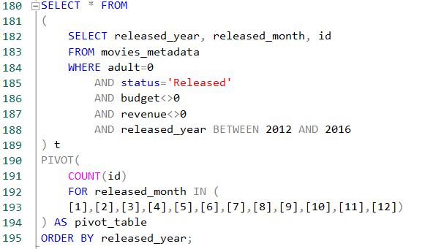
SQL
The Movie Industry | An Overview
PROCESS – Data Analysis
View YoY comparison of no. of movies released by month for the last 5 years
QUICK INSIGHT :
SQL PIVOT revealed some increases and decreases but not consistent over the months
A chart would be beneficial to get a sense of the overall picture

Slide 14
SQL
The Movie Industry | An Overview
PROCESS – Data Analysis
View TOP 30 movies released in the last 20 years, with highest ROI
View movies which bring in the most revenue
View movies which cost the most
QUICK INSIGHT :
Paranormal Activity and The Blair Witch Project has really fantastic ROIs !

Slide 15
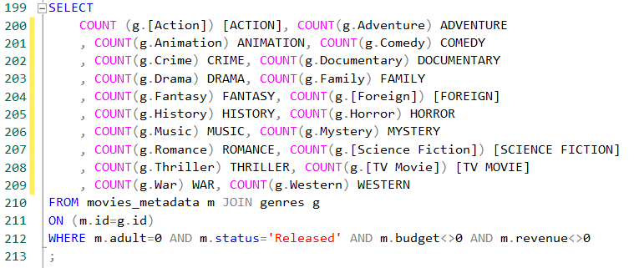
SQL
The Movie Industry | An Overview
PROCESS – Data Analysis
View no. of movies released by genre
***** Note: A movie can hold >1 genre *****
QUICK INSIGHT :
Genres of Thriller, Drama, Comedy, Action are the most released

Slide 16
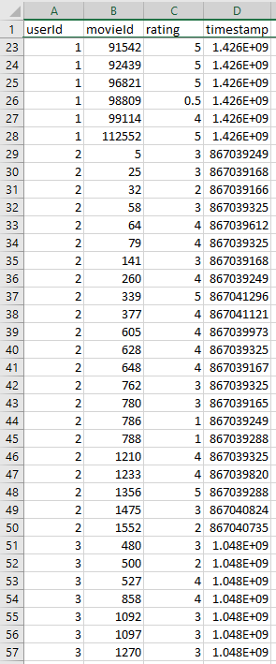
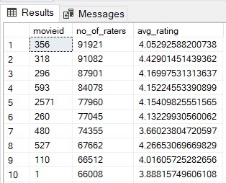
SQL
The Movie Industry | An Overview
PROCESS – Data Analysis
View details of movies with the highest no. of raters and the corresponding avg rating

Slide 17
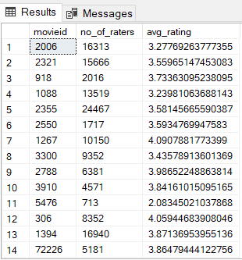
SQL
The Movie Industry | An Overview
PROCESS – Data Manipulation
Manipulate data to create a DATA DUMP for the Excel Interactive Dashboard

Slide 18
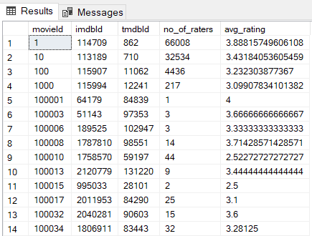
SQL
The Movie Industry | An Overview
PROCESS – Data Manipulation
Manipulate data to create a DATA DUMP for the Excel Interactive Dashboard

Slide 19
SQL
The Movie Industry | An Overview
PROCESS – Data Manipulation
Manipulate data to create a DATA DUMP for the Excel Interactive Dashboard

Slide 20
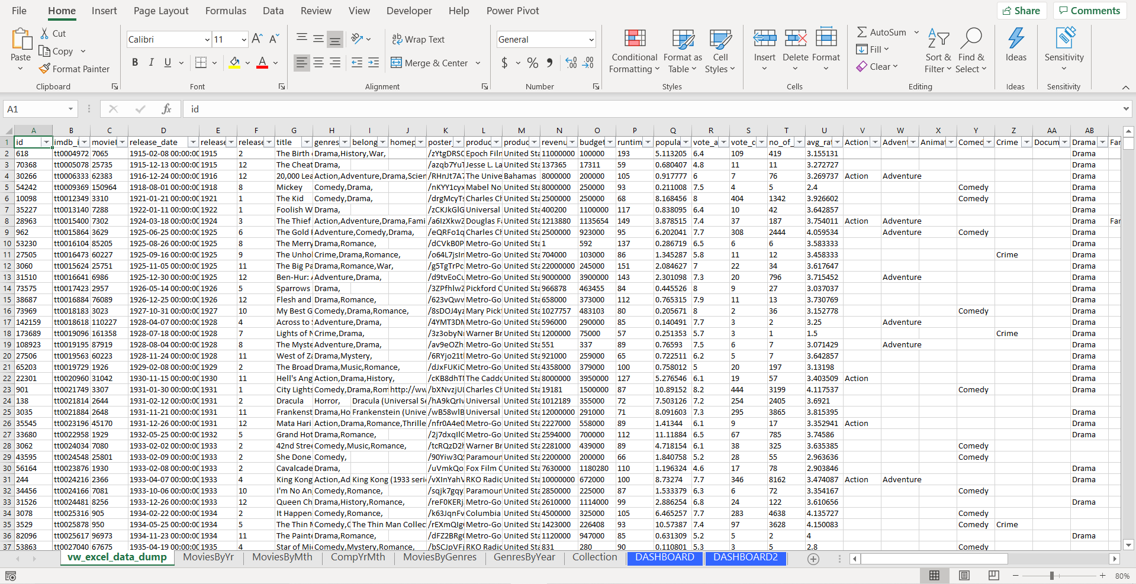
SQL
The Movie Industry | An Overview
PROCESS – Import data into Excel

Slide 21
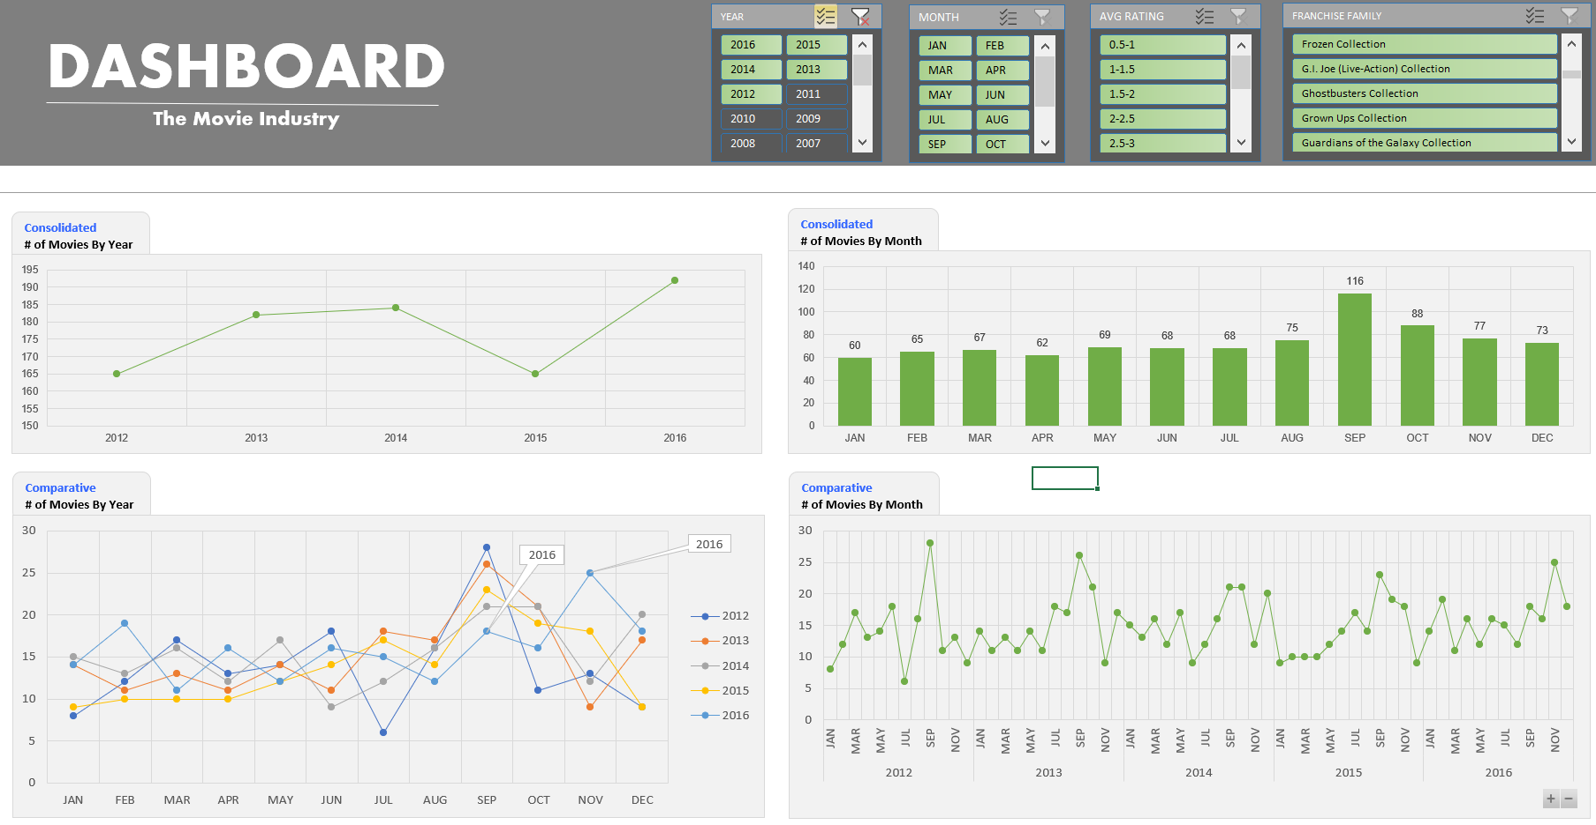
DASHBOARD TAKEAWAYS
The Movie Industry | An Overview
Takeaways:
Over the last 5 years:
No. of movies released are fairly stable, above the 165 mark, with its peak at 192 movies in 2016
By month wise, Sep has the most releases, followed by Oct
While the general highs are in Sep, 2016 seems to be an outlier whereby Nov saw the most releases … testing the market perhaps?

Slide 22
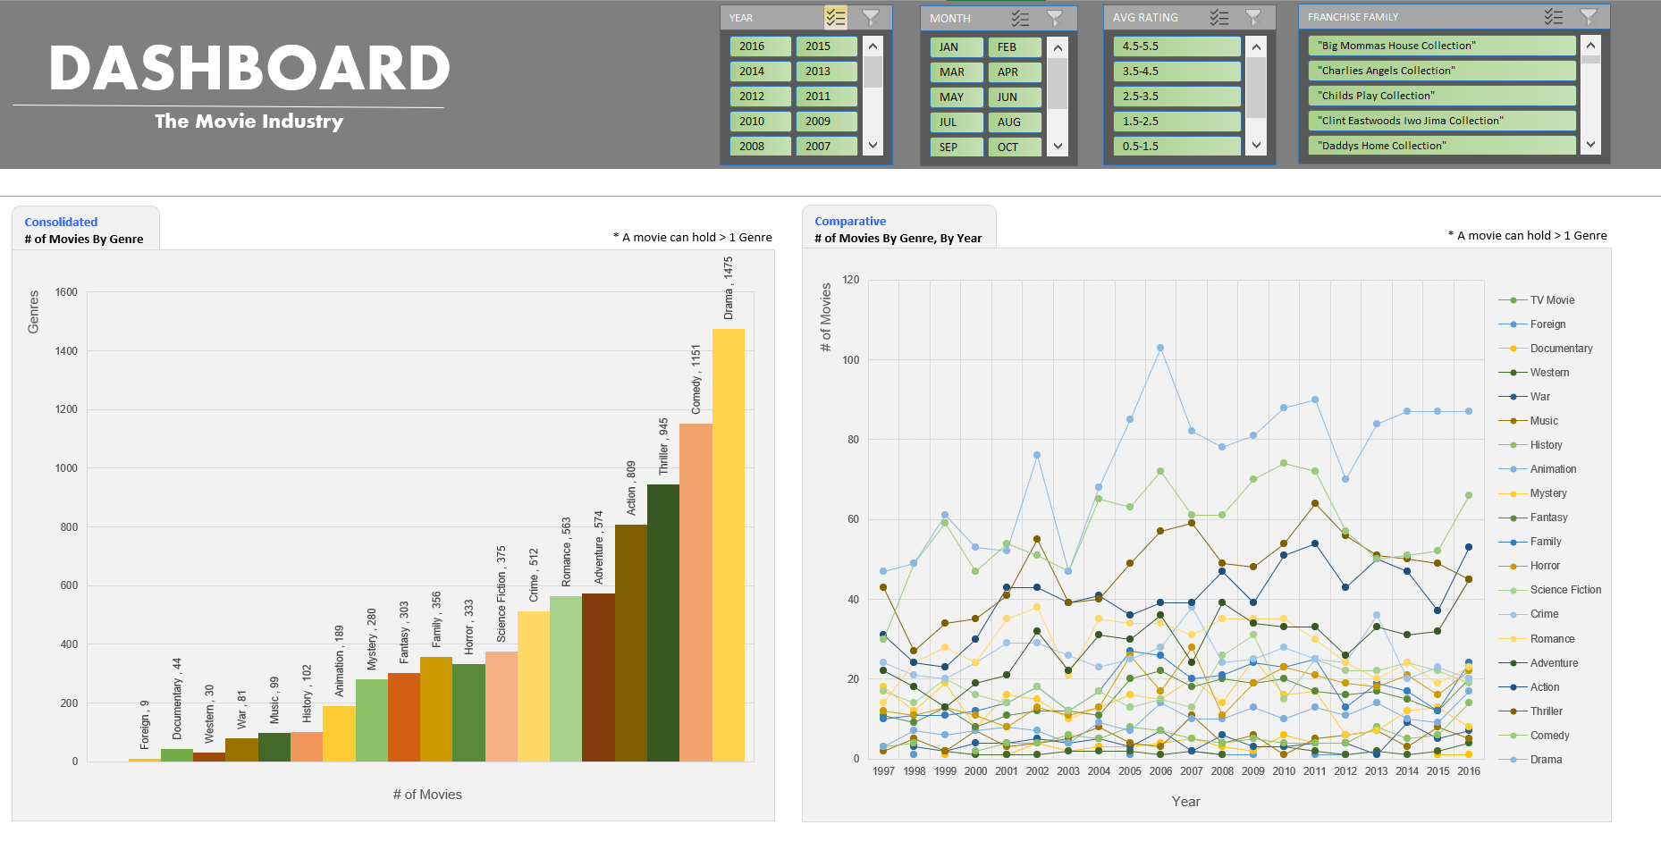
DASHBOARD TAKEAWAYS
The Movie Industry | An Overview
Takeaways:
Most released genre is Drama, followed by Comedy, then Thriller, followed by Action

Slide 23
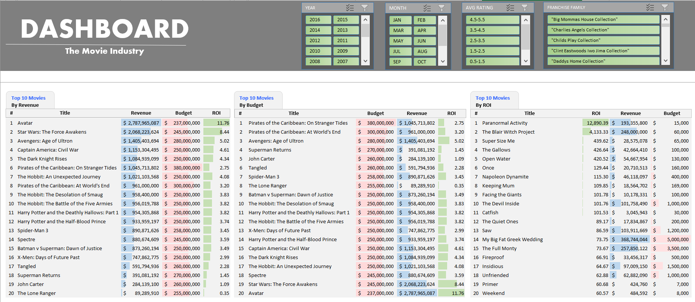
DASHBOARD TAKEAWAYS
The Movie Industry | An Overview
Takeaways:
Movies which bring in the most revenue are mostly Blockbusters
Most expensive to produce movies are mostly Blockbusters
Movies with the highest ROI seem to be Horror/Thriller films (e.g. Saw, Insidious, The Devil Inside, etc.) AND Comedy (e.g. Super Size Me, Keeping Mum, The Full Monty, etc.)
Paranormal Activity & The Blair Witch being outliers with massive ROIs!

Slide 24
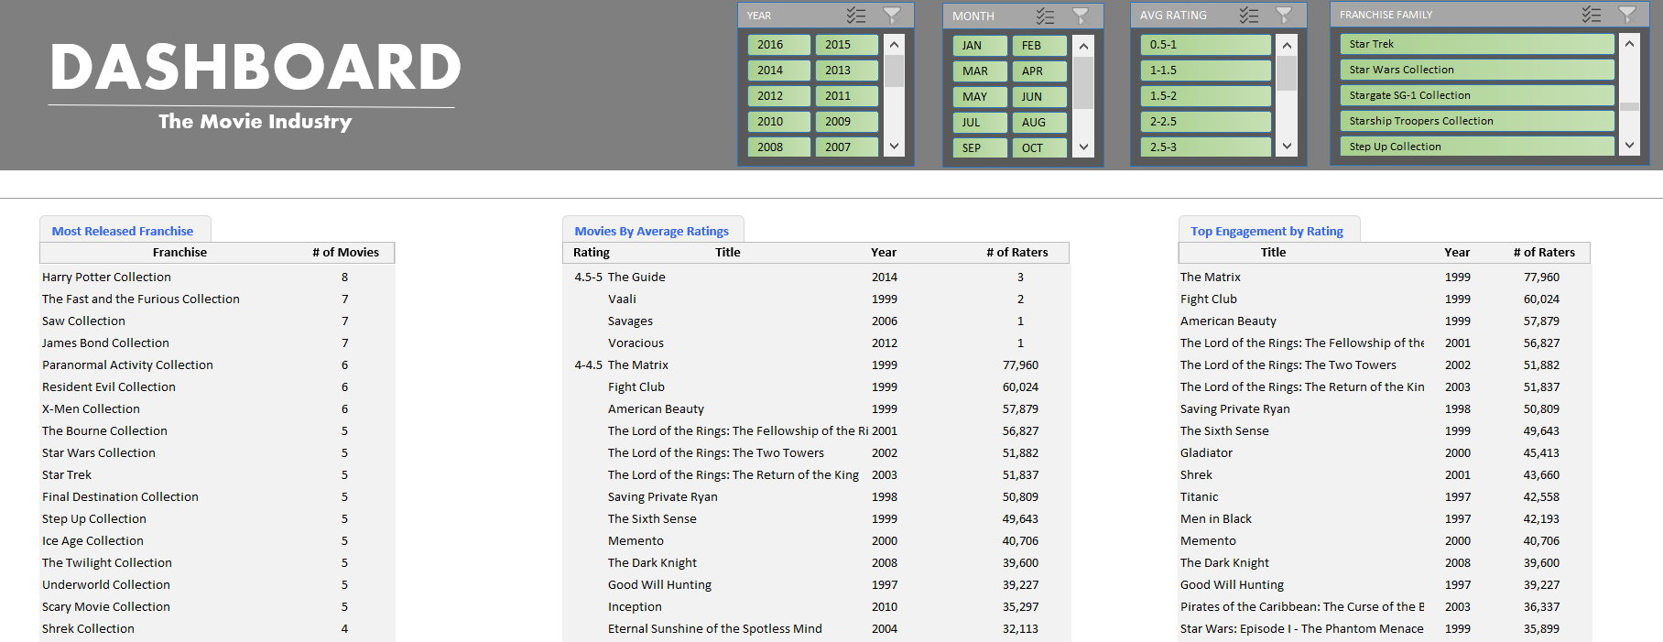
DASHBOARD TAKEAWAYS
The Movie Industry | An Overview
Takeaways:
Most released franchise movie is the collection of, Harry Potter, followed by The Fast & Furious, Saw, and James Bond with similar number of movie releases
Movies with highest engagement in terms of ratings is The Matrix, then Fight Club
The highest average rating of 4.5 – 5 is deemed to be not representative due to the extremely low number of raters
c
c

Slide 25
DASHBOARD TAKEAWAYS
The Movie Industry | An Overview
Dashboard Power !
Take for example, Star Wars Collection
Released in Year 1999, 2002, 2005, 2015, 2016
In Months of May and Dec
3 releases in May, 2 releases in Dec

Slide 26
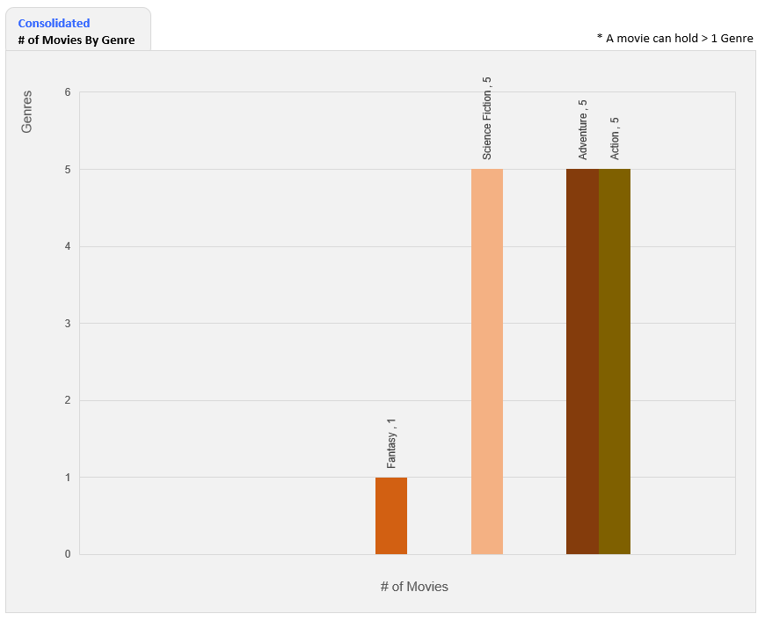
DASHBOARD TAKEAWAYS
The Movie Industry | An Overview
Dashboard Power !
Take for example, Star Wars Collection
Fall under the Genres of Action, Adventure, Science Fiction, Fantasy

Slide 27
DASHBOARD TAKEAWAYS
The Movie Industry | An Overview
Dashboard Power !
Take for example, Star Wars Collection
Efficient view of:
Each movie’s Revenue, Budget, ROI
Which movie tops in terms of engagement by number of raters
Corresponding rating per movie with # of raters

Slide 28
END
Thank You

